Slide 1
Robo sapiens = robo prospectus
Yiannis Aloimonos
Computer Vision Lab
Perception and Robotics Group
University of Maryland
www.prg.cs.umd.edu

Slide 2
Theory of Event Coding
Representations in = Representation in
Perception Execution

Slide 3
Basic cognitive ability
Understanding Others
Understanding Actions
Understanding Manipulation Actions

Slide 4
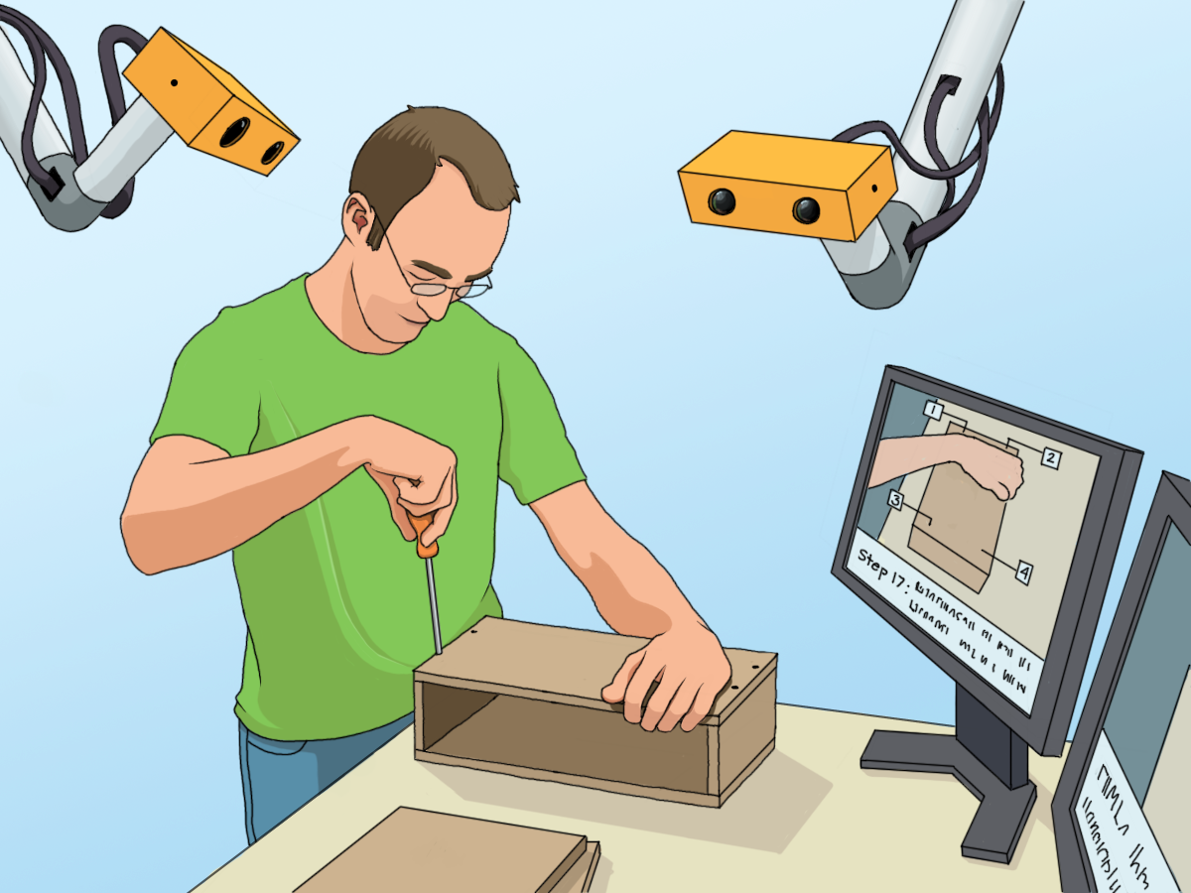

Slide 5
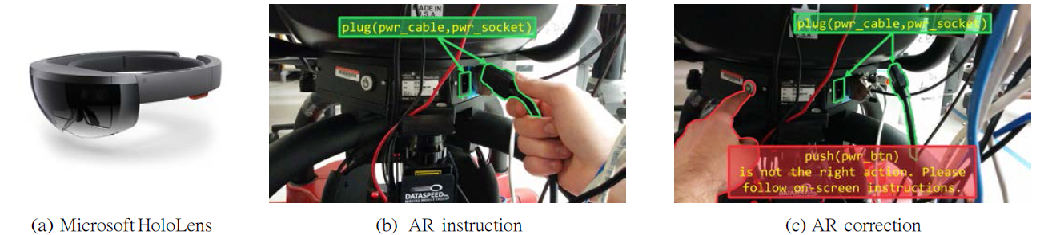
Augmented Reality

Slide 6
Central Thesis
We understand visual action in a way similar to the way we understand language.
There is syntax, a small set of rules for structuring the different components of the action.
There is semantics related to action consequences and goals.
We break parts of the video into meaningful chunks which we map into symbols which obey the grammar rules – we make a tree

Slide 7
How to segment the video
Using Basic Events
Contact
(A,B)→A+B
A+B → A , B
A → B

Slide 8
4 possibilities
A new object can become part of the activity
2. One object can transform into another object
3. Multiple objects can combine into one object
4. One object can separate into multiple objects

Slide 9
How the activity tree is changing
1. When an object is touched (either directly by a hand or by a tool being used by the hand), a new node is created.
2. When an object transforms from A to B, a new node labeled B is created and attached as a subtree to node A.
3. When multiple objects (A,B) combine into one object A+B, a new node labeled A+B is created the subtrees associated with A and B are attached (as subtrees) to A+B.
4. When one object A+B separates into multiple objects (A,B), new nodes A and B are created and attached as subtrees to the node A+B.
5. In addition to the above, a new node can be created for an object already used in the activity, if it is being used as part of a new assembly or disassembly.

Slide 10
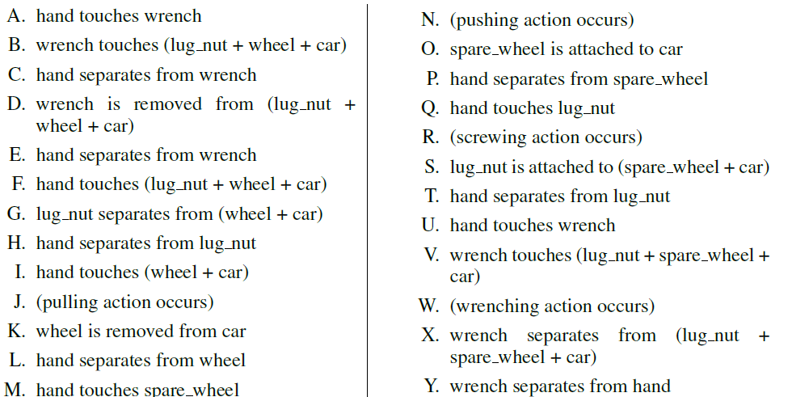
Changing the wheel of a car

Slide 11
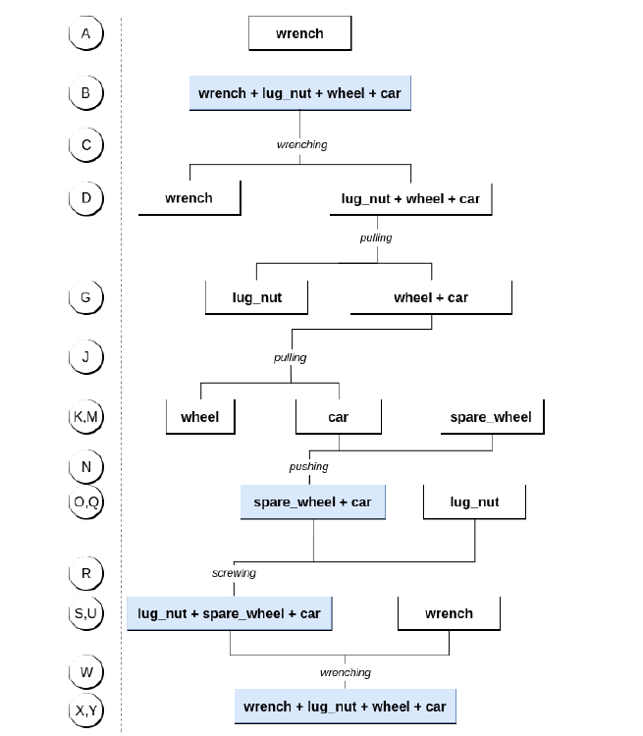

Slide 12
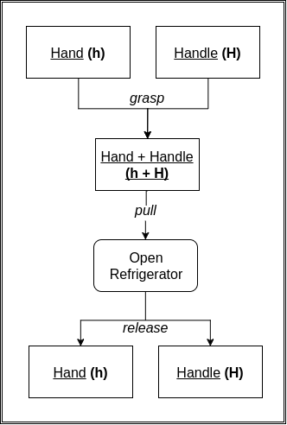
Open Refrigerator

Slide 13
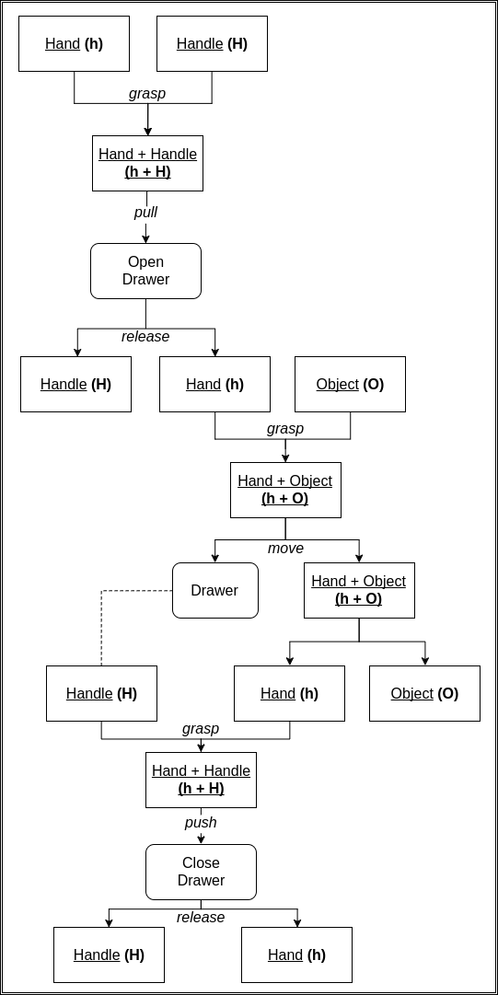
Open the drawer and fetch an object from inside

Slide 14
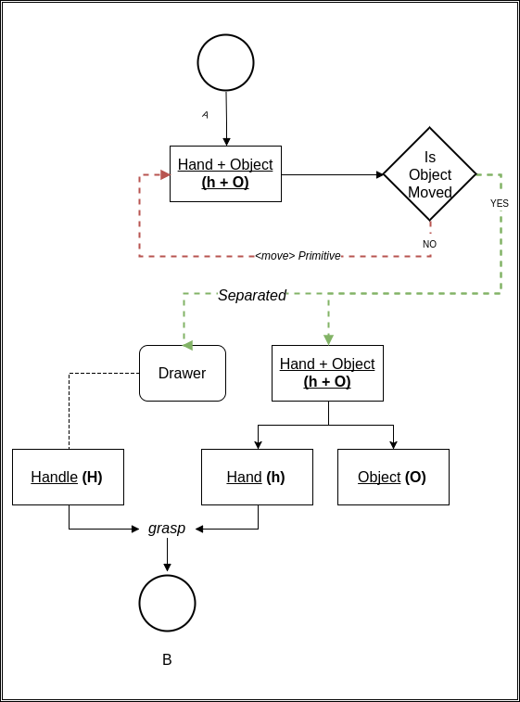

Slide 15
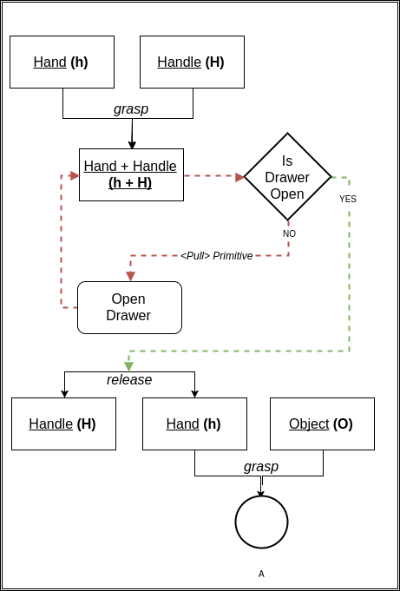

Slide 16
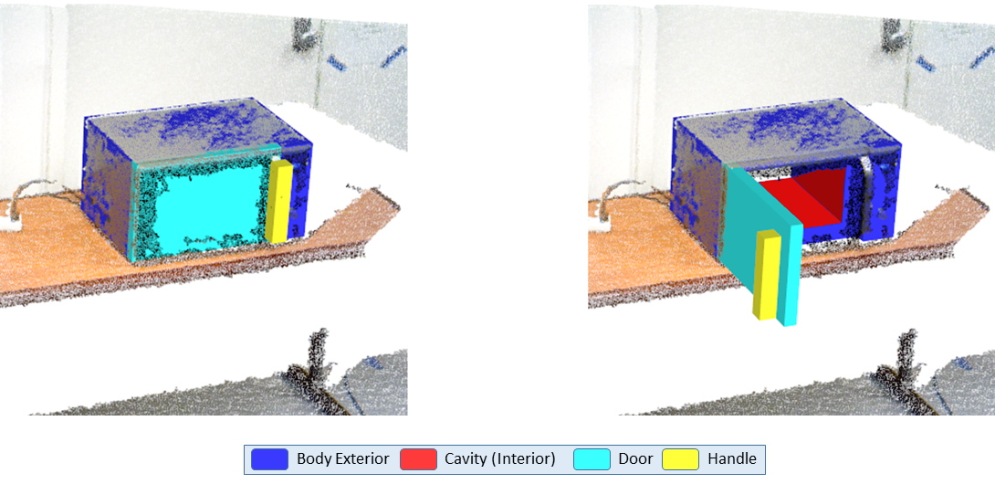
Action consequences
Fig. 4. Example model output with pointcloud overlay on microwave with labeled parts. Individual parts fitted to the source point cloud of the microwave are highlighted in different colors. (Left) reconstruction from static observations. (Right) Reconstruction after manipulation, i.e.opening the door.

Slide 17
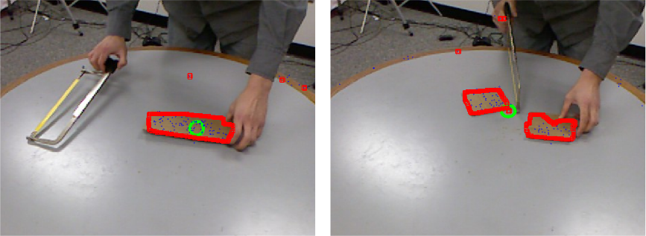
Action consequences

Slide 18
Primitives (actions amount to the transfer of force)
Push (instrument, location, force)
Pull
Slide
Move
Align
Turn
Grasp-in-order-to

Slide 19
Our unique contribution
Cilantro: An open source library for handling pointcloud data

